Slide 1
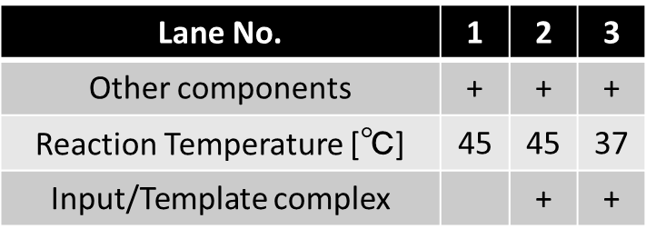
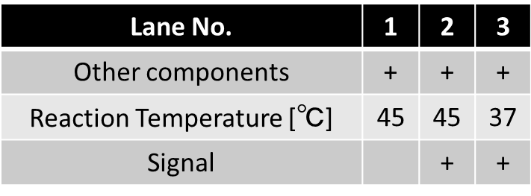
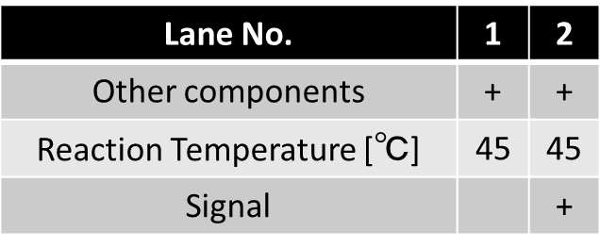
Input/Template complex
Other components :
Input
Gate
Polymerase
EcoRI
dNTP.
Updated Complex
Output complex
Waste
Waste
Signal
Other components :
Transducer
Polymerase
dNTP
Output Strand
Other components :
Input/Template complex
Polymerase
Nickase
dNTP.
Lane No. | 1 | 2 | 3
Other components | + | + | +
Reaction Temperature [℃] | 45 | 45 | 37
Signal |  | + | +
Lane No. | 1 | 2
Other components | + | +
Reaction Temperature [℃] | 45 | 45
Signal |  | +
Lane No. | 1 | 2 | 3
Other components | + | + | +
Reaction Temperature [℃] | 45 | 45 | 37
Input/Template complex |  | + | +

Slide 2
Lane No. | 1 | 2 | 3
Other components | + | + | +
Reaction Temperature [℃] | 45 | 45 | 37
Input/Template complex |  | + | +
Lane No. | 1 | 2 | 3
Other components | + | + | +
Reaction Temperature [℃] | 45 | 45 | 37
Signal |  | + | +
Input/Template complex
Other components :
Input
Gate
Polymerase
EcoRI
dNTP.
Updated Complex
Output complex
Waste
Waste
Other components :
Input/Template complex
Polymerase
Nickase
dNTP.
Other components :
Transducer
Polymerase
dNTP
Signal
Output
Lane No. | 1 | 2
Other components | + | +
Reaction Temperature [℃] | 45 | 45
Signal |  | +
Notes:
Readとrelease縦と横が揃っているよ

Slide 3
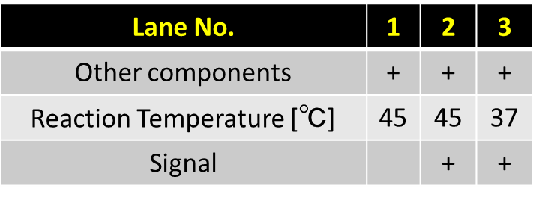
Waste
Output complex
Output Strand

Slide 4
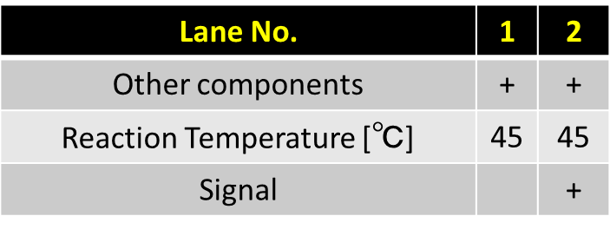
Updated Complex
Waste

Slide 5
1
2
3
1
2
3
4
1
2
3
4
1
2
3
4
1
2
3
4

Slide 6
1
2
3
4
1
2
3
4
1
2
3
1
2
3
4
1
2
3
4

Slide 8
Lane No. | 1 | 2 | 3 | 4 | 5 | 6 | 7 | 8 | 9 | 10 | 11
Reaction Time [min] | 1 | 2 | 5 | 10 | 12 | 15 | 20 | 25 | 30 | 60 | 100
Lane No. | 1 | 2 | 3 | 4 | 5 | 6 | 7 | 8 | 9 | 10 | 11 | 12
Reaction Time [min] | 1 | 2 | 5 | 10 | 12 | 15 | 20 | × | 25 | 30 | 60 | 100
Transducer A
Transducer A
Output A
Output A

Slide 9
Lane No. | 1 | 2 | 3 | 4 | 5 | 6 | 7 | 8 | 9 | 10 | 11
Reaction Time [min] | 1 | 2 | 5 | 10 | 12 | 15 | 20 | 25 | 30 | 60 | 100
Lane No. | 1 | 2 | 3 | 4 | 5 | 6 | 7 | 8 | 9 | 10 | 11 | 12
Reaction Time [min] | 1 | 2 | 5 | 10 | 12 | 15 | 20 | × | 25 | 30 | 60 | 100
Transducer A
Transducer A
Output A
Output A

Slide 10
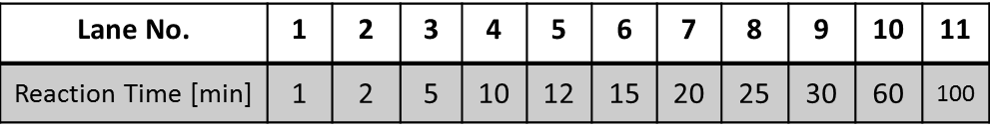
Lane No. | 1 | 2 | 3 | 4 | 5 | 6 | 7 | 8 | 9 | 10 | 11 | 12
Reaction Time [min] | 1 | 2 | 5 | 10 | 12 | 15 | 20 | × | 25 | 30 | 60 | 100
Transducer A
Transducer A
Output A
Output A

Slide 11
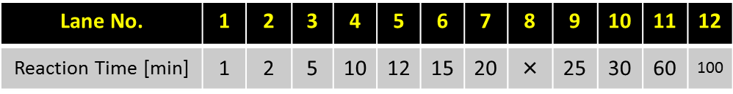
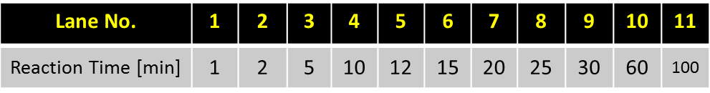
Input-AB
Transducer-A
Output-A
Input-BA
Transducer-A
Output-A

Slide 12
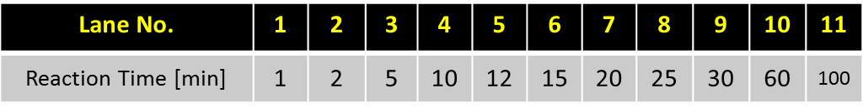
Output B
Output B
Output A
Output A

Slide 13
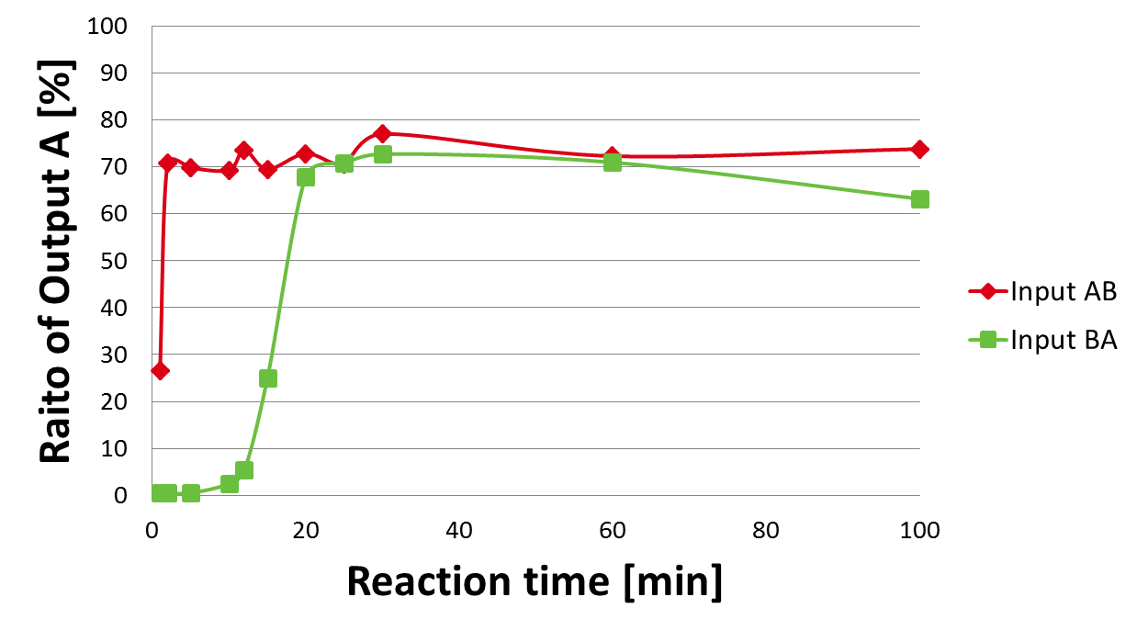

Slide 15
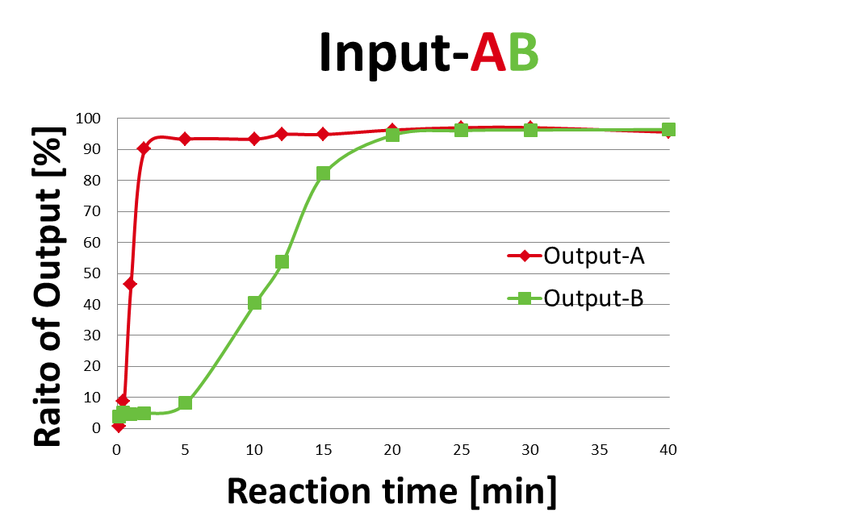
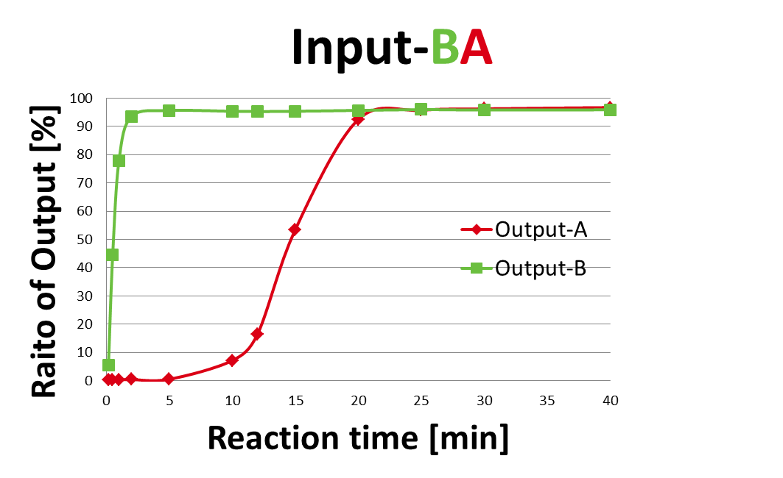

Slide 17
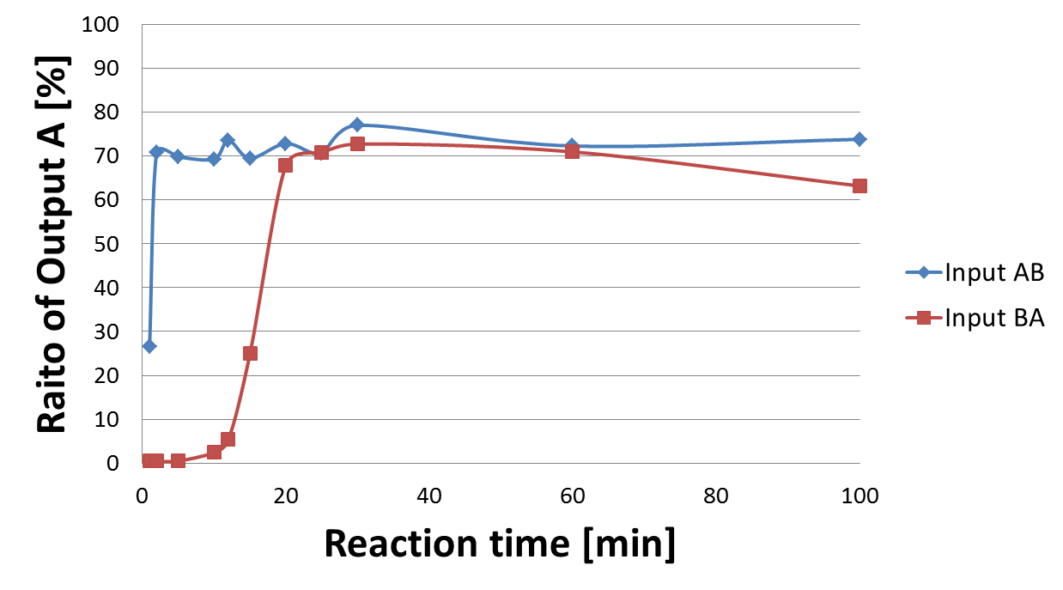

Slide 18
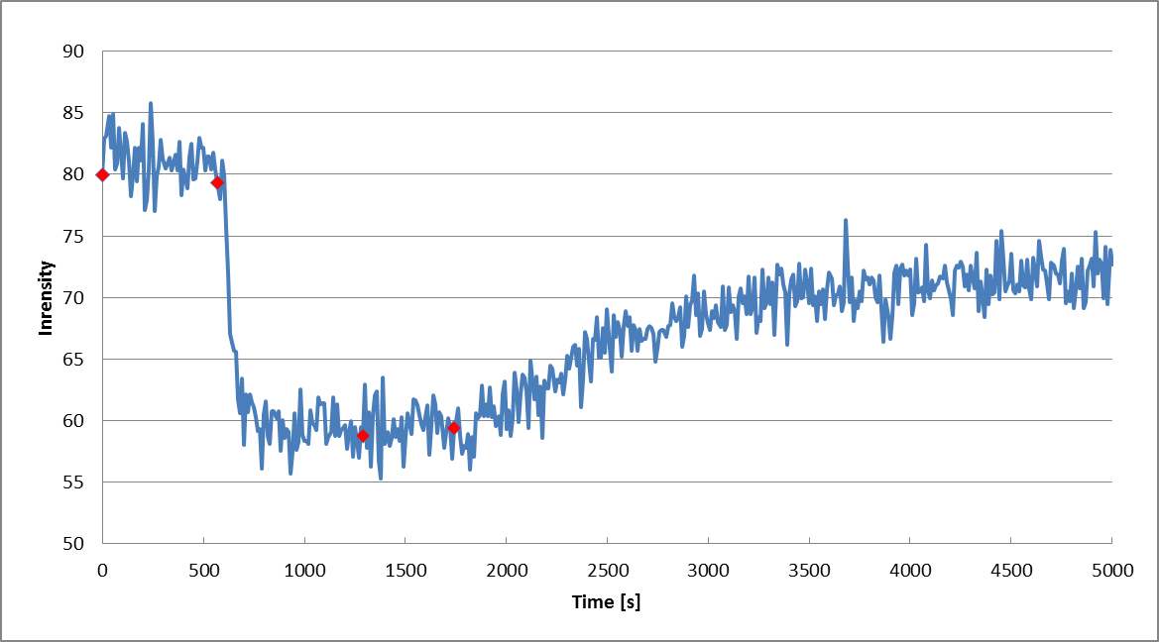
mO
+ mO*
+ I - I*
+ Trigger

Slide 20
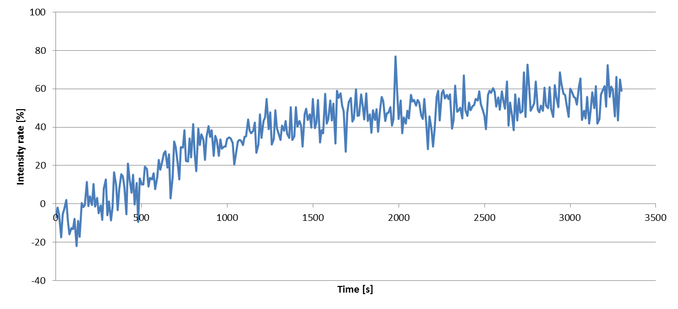

Slide 21
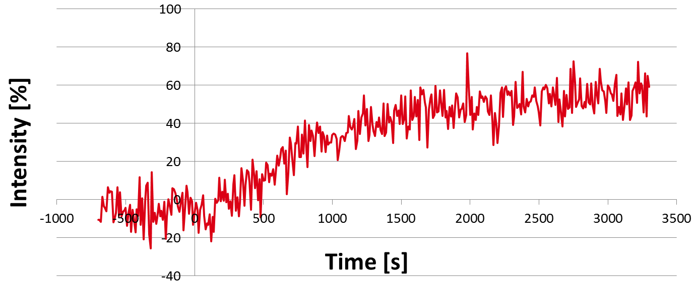

Slide 22
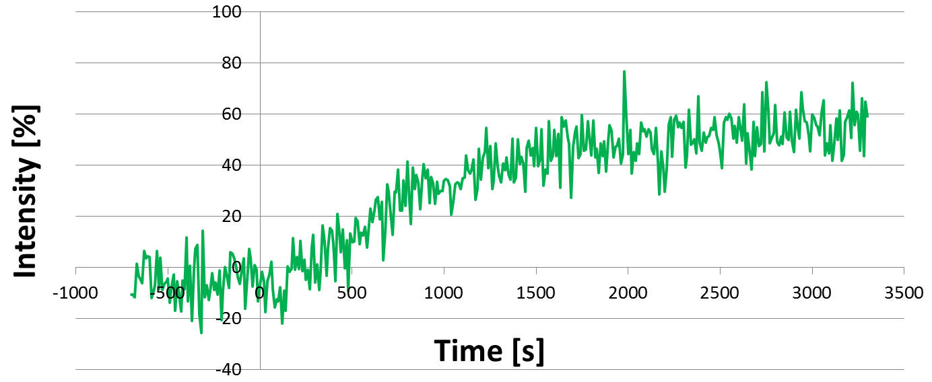

Slide 23
1
2
3
Input & Template complex
Input
Template
Key Strand

Slide 24
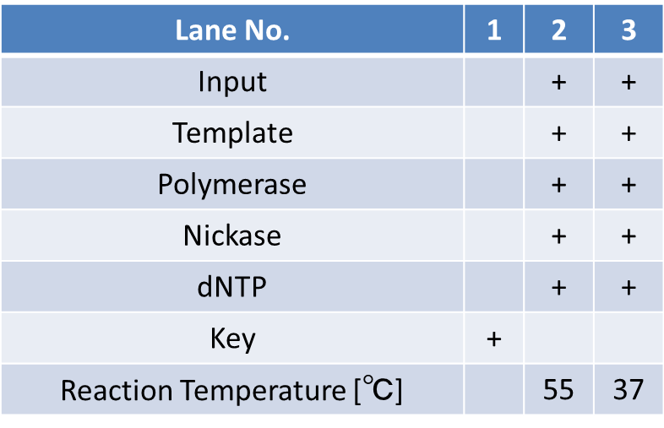
Input & Template complex
Input
Template
Key Strand
Notes:
表はコピーして図として貼り付けた後にグループ化しましょうBy今井

Slide 25
Lane No. | 1 | 2 | 3
Input |  | + | +
Template |  | + | +
Polymerase |  | + | +
Nickase |  | + | +
dNTP |  | + | +
Key | +
Reaction Temperature [℃] |  | 55 | 37
Input & Template complex
Input
Template
Key Strand
Notes:
表はコピーして図として貼り付けた後にグループ化しましょうBy今井

Slide 26
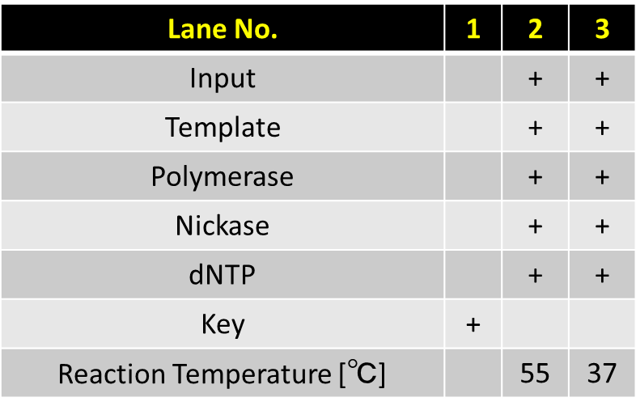
Input & Template complex
Input
Template
Key Strand
Notes:
表はコピーして図として貼り付けた後にグループ化しましょうBy今井

Slide 27
Lane No. | 1 | 2 | 3
Output | + | + | +
Holder | + | + | +
Polymerase | + | + | +
dNTP | + | + | +
Signal |  | + | +
Reaction Temperature [℃] | 45 | 45 | 37
Input/Template complex
Signal

Slide 28
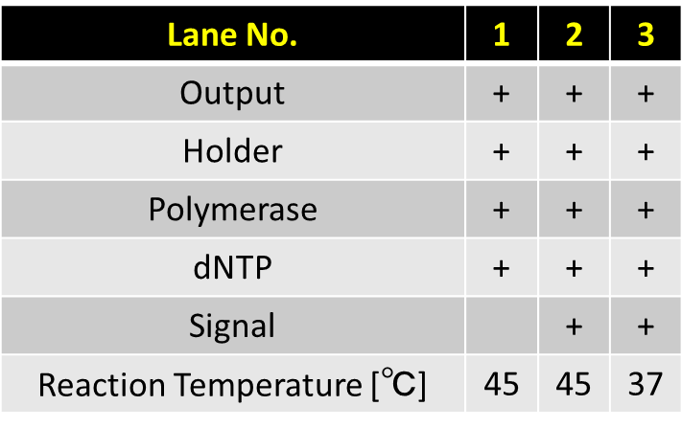
Input/Template complex
Signal

Slide 29
Lane No. | 1 | 2 | 3
Other components | + | + | +
Reaction Temperature [℃] | 45 | 45 | 37
Signal |  | + | +
Input/Template complex
Signal

Slide 30

Other components :
Input/Template complex
Polymerase
Nickase
dNTP.
Input/Template complex
Signal

Slide 31
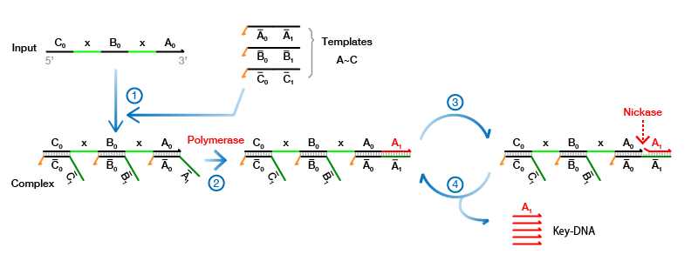

Slide 32
1
2
3
4
Anchor & Output
Waste
Output Strand
Output Strand

Slide 33
1
2
3
4
Anchor & Output
Waste
Output Strand
Output Strand

Slide 34
1
2
3
4
Anchor & Output
Waste
Output Strand
Output Strand

Slide 35
Lane No. | 1 | 2 | 3 | 4
Anchor | + | + | + | +
Output |  | + | + | +
Polymerase |  | + | + | +
dNTP |  | + | + | +
Key |  |  | + | +
Reaction Temperature [℃] |  | 37 | 37 | 65
Anchor & Output
Waste
Output Strand
Output Strand

Slide 36
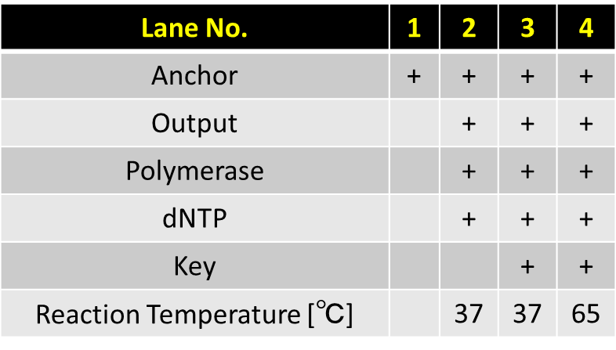
Anchor & Output
Waste
Output Strand
Output Strand

Slide 37
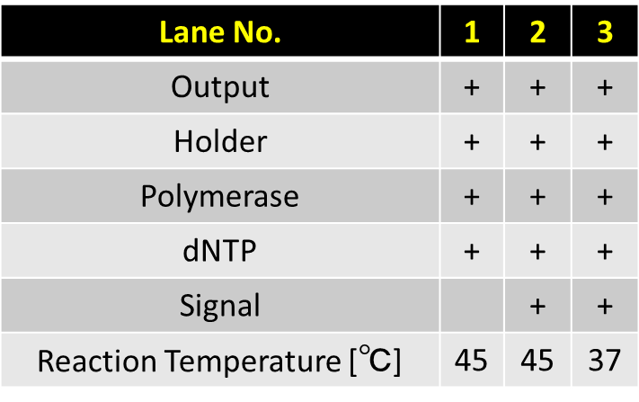
Waste
Output complex
Output Strand

Slide 38
Lane No. | 1 | 2 | 3
dNTP | + | + | +
Reaction Temperature [℃] | 45 | 45 | 37
Signal |  | + | +
Waste
Output complex
Output Strand

Slide 39
Waste
Output complex
Output Strand

Slide 40
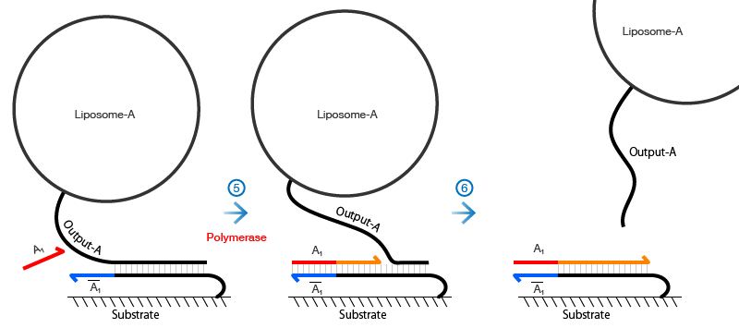
Waste

Slide 41
1
2
3
Gate
Fragment 1
Fragment 1
Fragment 2
Fragment 3

Slide 42
1
2
3
Gate complex
Fragment 1
Fragment 1
Signal
Next Complex
Fragment 2

Slide 43
1
2
3
Gate
Fragment 1
Fragment 1
Signal
Next Complex
Fragment 2 ssdna

Slide 44
Lane No. | 1 | 2 | 3
Input | + | + | +
Gate | + | +
Polymerase | + | +
dNTP | + | +
Key |  | +
Signal |  |  | +
EcoRI | + | + | +
Reaction Temperature [℃] | 45 | 45 | 45
Gate
Fragment 1
Fragment 1
Signal
Next Complex
Fragment 2 ssdna

Slide 45
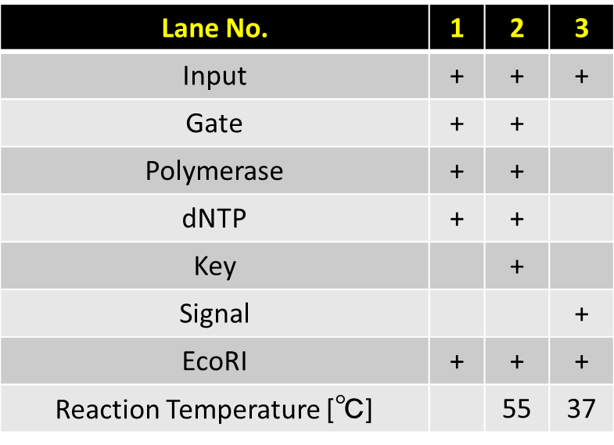
Gate
Fragment 1
Fragment 1
Signal
Next Complex
Fragment 2 ssdna

Slide 46
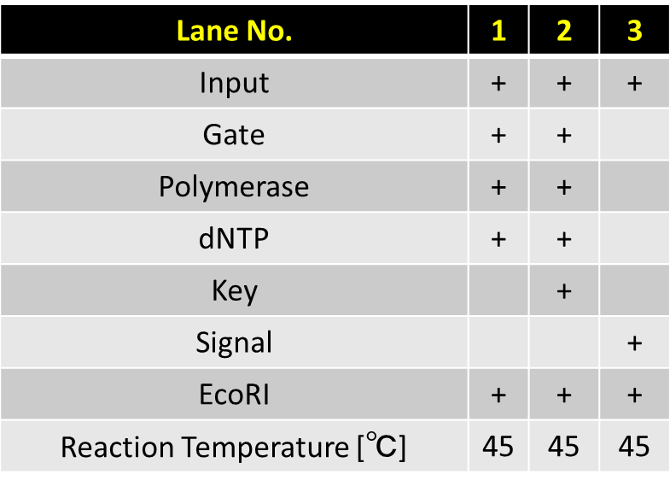
Gate complex
Fragment 1
Fragment 1
Signal
Next Complex
Fragment 2

Slide 47
Lane No. | 1 | 2
Input | + | +
Gate | + | +
Polymerase | + | +
dNTP | + | +
Signal |  | +
EcoRI | + | +
Reaction Temperature [℃] | 45 | 45
Updated Complex
Fragment

Slide 48
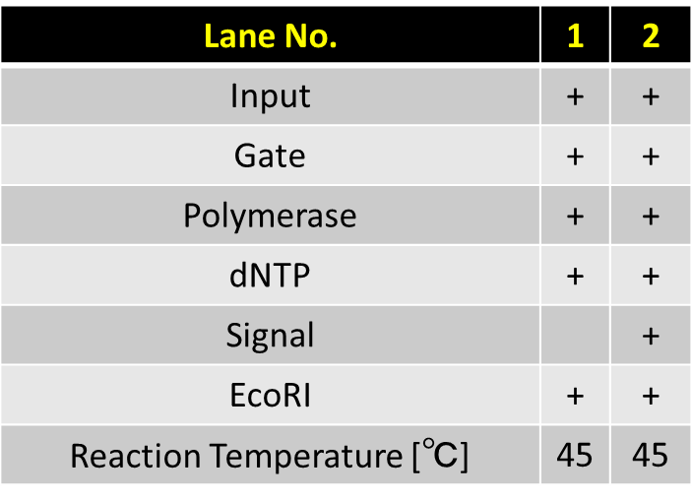
Updated Complex
Fragment

Slide 49
Lane No. | 1 | 2
Other components | + | +
Reaction Temperature [℃] | 45 | 45
Signal |  | +
Updated Complex
Fragment

Slide 50
Updated Complex
Waste

Slide 51
Lane No. | 1 | 2 | 3 | 4 | 5 | 6 | 7 | 8
Enzymes & dNTP | + | + | + | + | + | + | +
Transducer | + | + | + | + | + | + | +
Output |  |  |  |  |  |  |  | +
Template | + | + | + | + | + | + | +
Input |  | + | + | + | + | + | +
Reaction Time [min] |  | 1 | 2 | 5 | 10 | 20 | 50
Transducer
Output

Slide 52
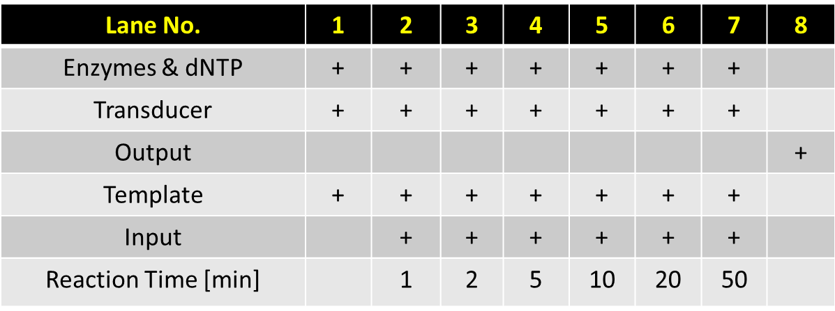
Transducer-A
Output-A

Slide 53
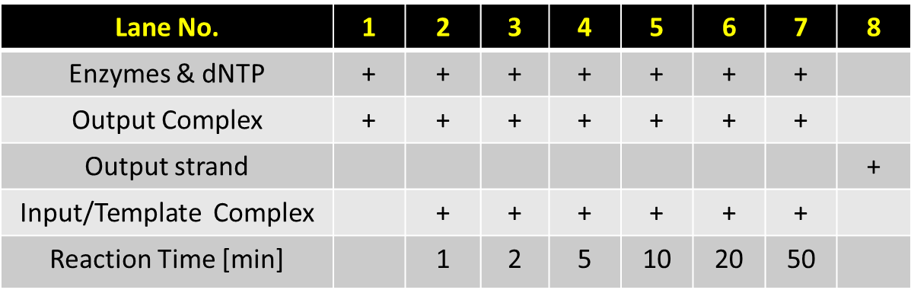
Signal

Slide 54
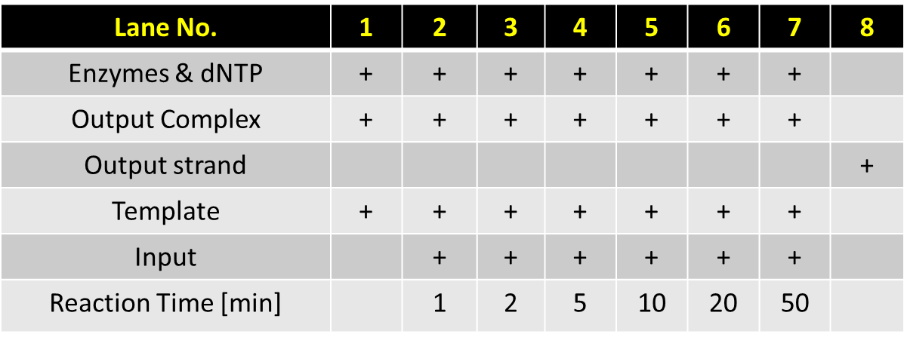
Signal

Slide 55
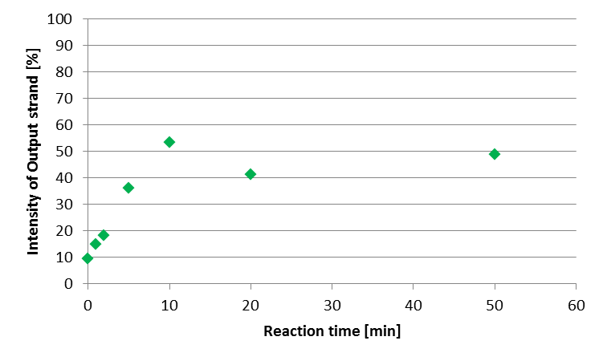
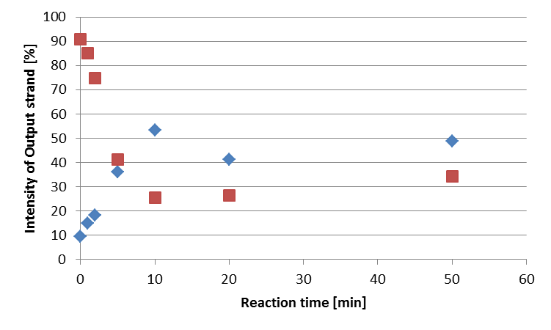

Slide 56
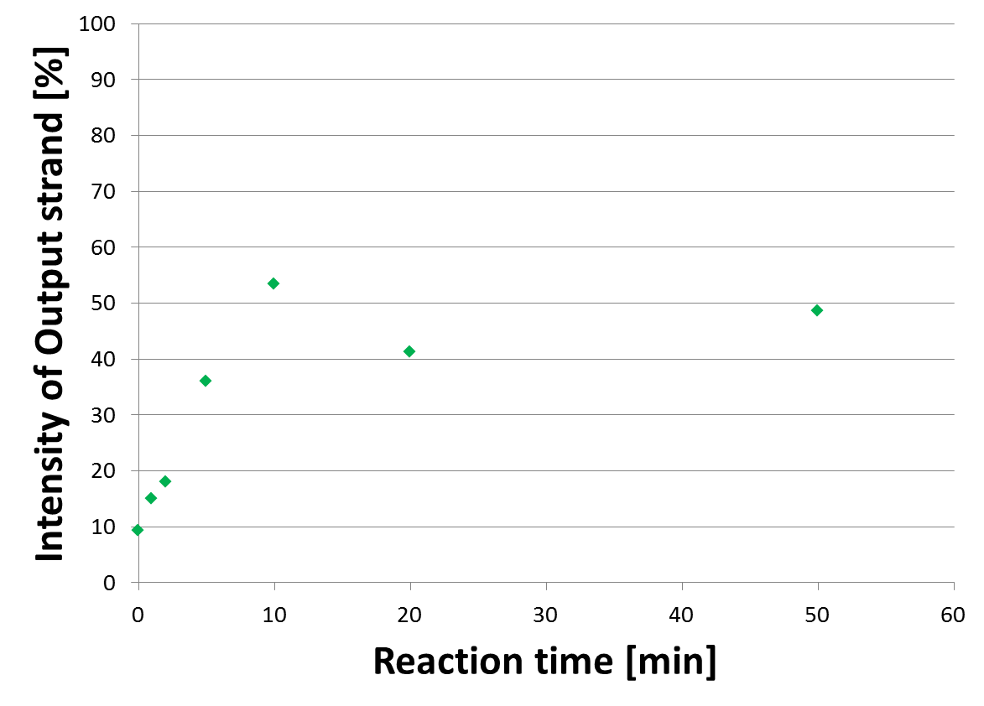

Slide 57
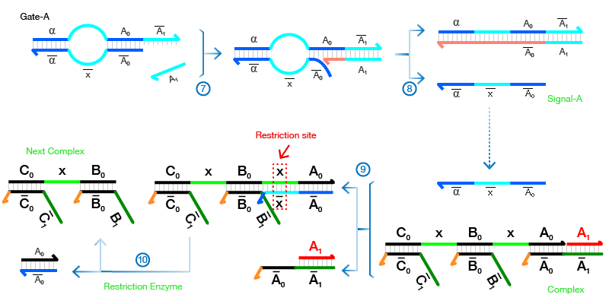

Slide 58
Fluorescence
Stained
1
2
3
4
1
2
3
4
Input &Input*
Output &Output*
Output Strand with FAM
Output with FAM &Output*
Output &Output*
Output Strand

Slide 59
Lane No. | 1 | 2 | 3 | 4
Anchor | + | + | + | +
Output |  | + | + | +
Polymerase |  | + | + | +
dNTP |  | + | + | +
Key |  |  | + | +
Reaction Temperature [℃] |  | 37 | 37 | 65
Lane No. | 1 | 2 | 3 | 4
Anchor | + | + | + | +
Output |  | + | + | +
Polymerase |  | + | + | +
dNTP |  | + | + | +
Key |  |  | + | +
Reaction Temperature [℃] |  | 37 | 37 | 65
Input &Input*
Output &Output*
Output with FAM &Output*
Output Strand with FAM
Output &Output*
Output Strand
Fluorescence
Stained

Slide 60
Lane No. | 1 | 2 | 3 | 4
Input Complex | + | + | + | +
Output Complex |  | + | + | +
Trigger |  | + | +
FAM modified Output |  | + |  | +
Lane No. | 1 | 2 | 3 | 4
Input Complex | + | + | + | +
Output Complex |  | + | + | +
Trigger |  | + | +
FAM modified Output |  | + |  | +
Input &Input*
Output &Output*
Output with FAM &Output*
Output Strand with FAM
Output &Output*
Output Strand
Fluorescence
Stained

Slide 61
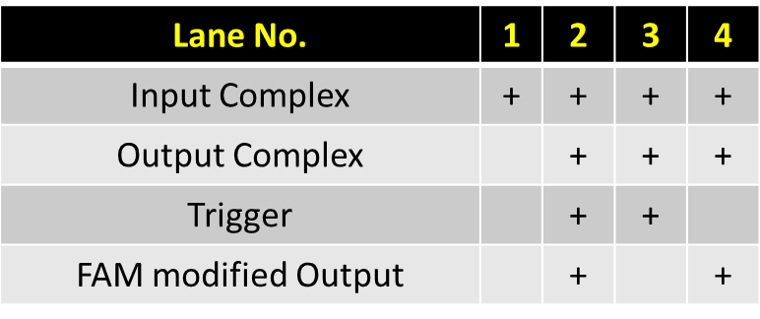
Input &Input*
Output &Output*
Output Strand with FAM
Output with FAM &Output*
Output &Output*
Output Strand
Fluorescence
Stained

Slide 62
Input &Input*
Output &Output*
Output Strand with FAM
Output with FAM &Output*
Output &Output*
Output Strand
Fluorescence
Stained

Slide 63
Lane No. | 1 | 2 | 3
Input | + | + | +
Transducer | + | + | +
Trigger | + | +
FAM modified Output | + |  | +
Output &Output*
Output Strand with FAM

Slide 64
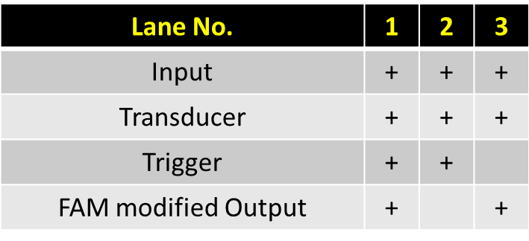
Transducer
Output

Slide 65
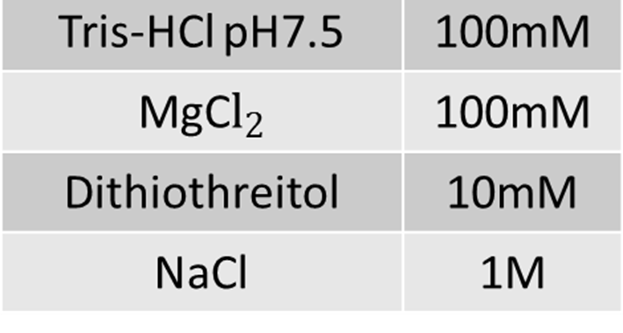
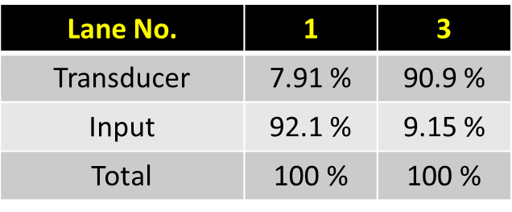
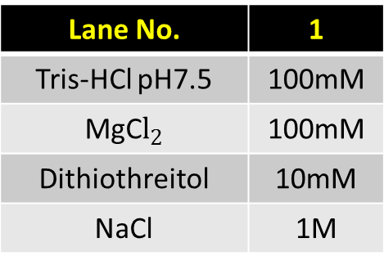
Lane No. | 1
Tris-HCl pH7.5 | 100mM
MgC$l_{2}$ | 100mM
Dithiothreitol | 10mM
NaCl | 1M
Lane No. | 1 | 3
Transducer | 7.91 % | 90.9 %
Input | 92.1 % | 9.15 %
Total | 100 % | 100 %

Slide 66
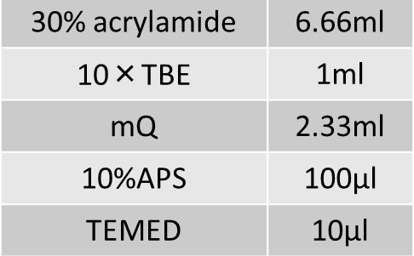
Lane No. | 1
30% acrylamide | 6.66ml
10×TBE | 1ml
mQ | 2.33ml
10%APS | 100μl
TEMED | 10μl

Slide 67
Lane2
Lane4

Slide 69
Rf Number [-] : 0.790
Band intensity [%] : 9.15 %
Lane 4
Rf Number [-] : 0.663
Band intensity [%] : 90.9 %

Slide 70
Lane 2
Rf Number [-] : 0.788
Band intensity [%] : 92.1 %
Rf Number [-] : 0.663
Band intensity [%] : 7.91 %

Slide 73
Rf Number [-] : 0.662609
Band intensity [%] : 7.908682
Rf Number [-] : 0.662609
Band intensity [%] : 90.85057
Rf Number [-] : 0.787826
Band intensity [%] : 92.091318
Rf Number [-] : 0.789565
Band intensity [%] : 9.149427

Slide 74
Lane 2
Lane 4
Rf Number [-] : 0.662609
Band intensity [%] : 7.908682
Rf Number [-] : 0.662609
Band intensity [%] : 90.85057
Rf Number [-] : 0.787826
Band intensity [%] : 92.091318
Rf Number [-] : 0.789565
Band intensity [%] : 9.149427

Slide 76
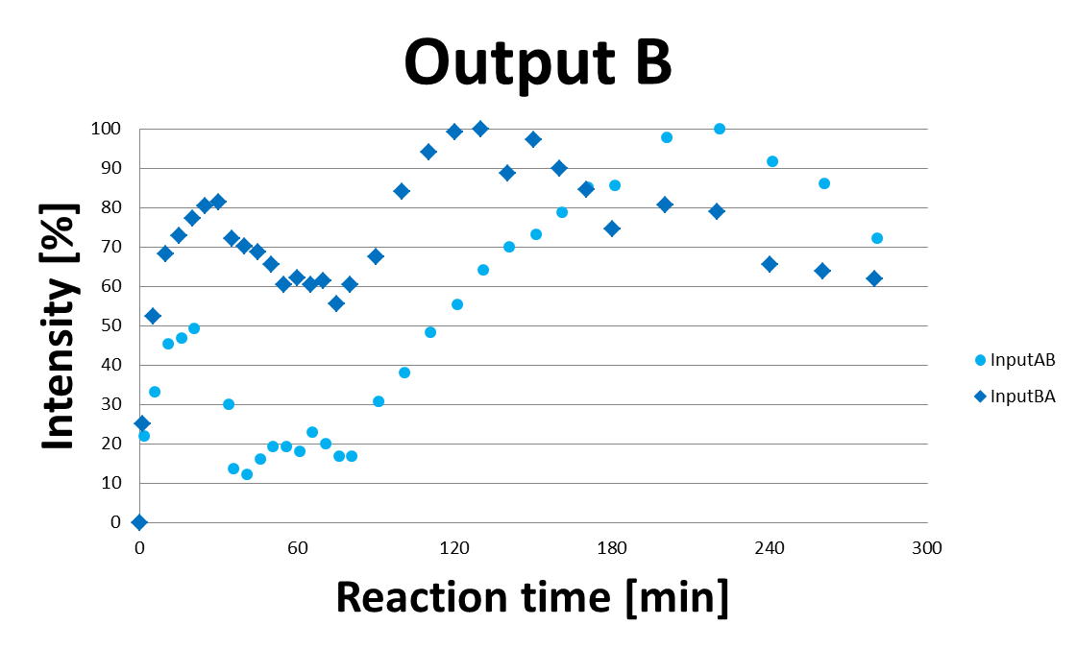
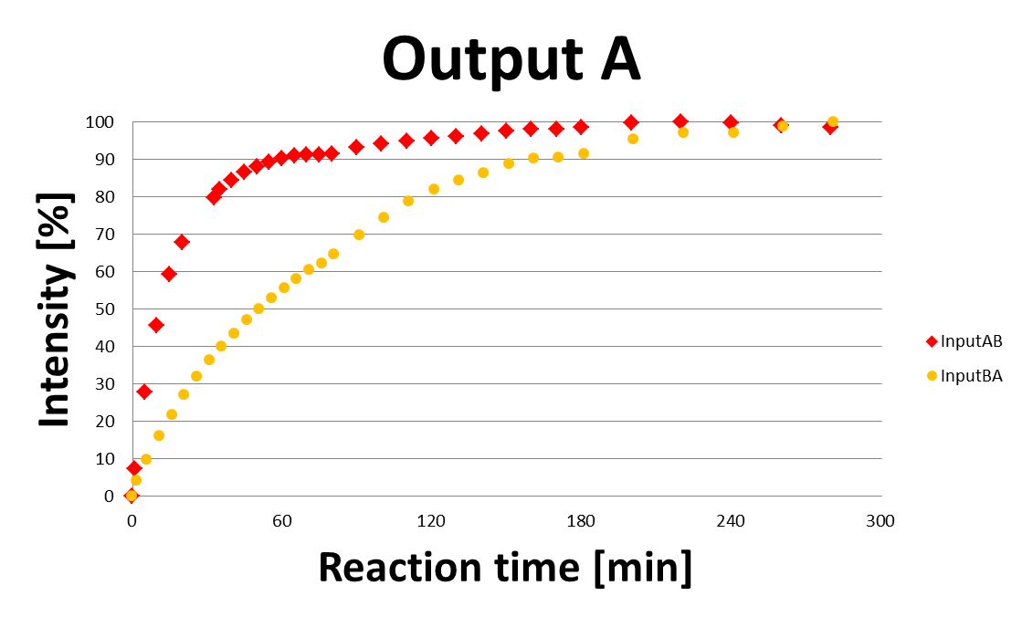

Slide 78
